Slide 1
Bypassing Door Passwords
Yunus AYDIN - in/aydinnyunus

Slide 2
whoami
- Application Security Engineer at Trendyol
- Security Researcher

Slide 3
Ethics

Slide 4
./how-locks-work.sh
- How Smart Locks work ?

Slide 5
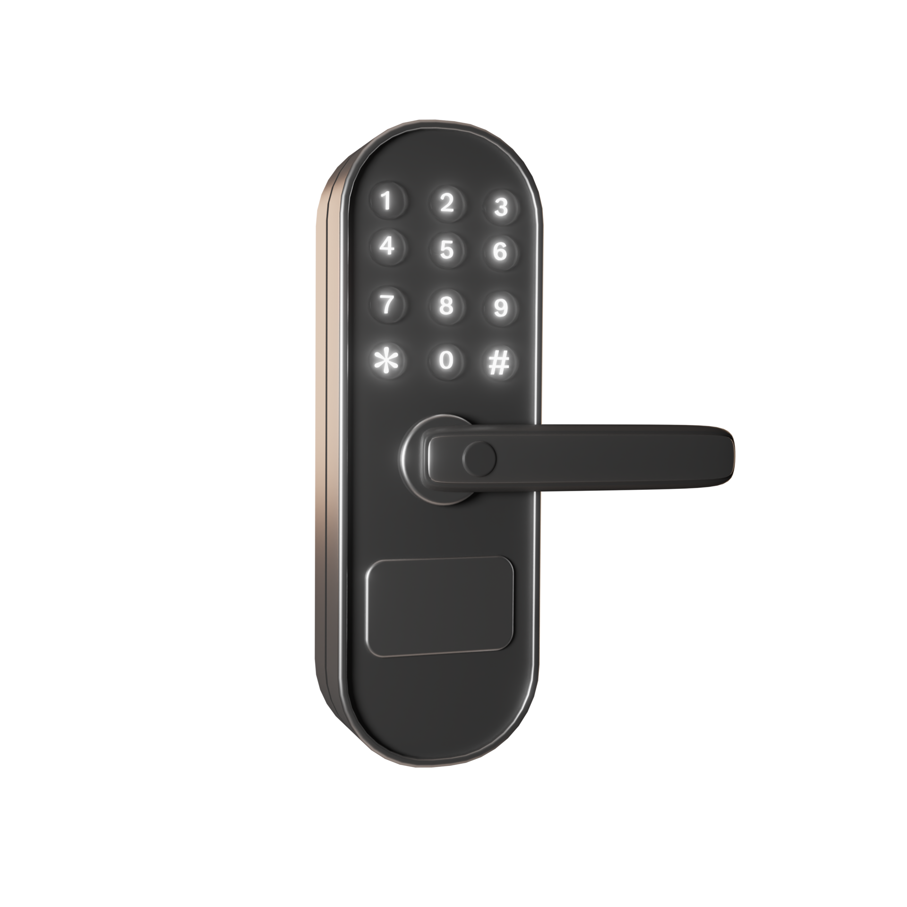
./how-locks-work.sh
- Keypad Interface
- Password Verification
- Lock Mechanism Activation
- Incorrect Attempts and Security Measures

Slide 6
./how-locks-work.sh
- How Smart Locks work ?
- How Smart Locks work in Housing Complex ?

Slide 7
Housing Complex CENSORED

Slide 8
./target.sh
- Smart Padlocks in Turkey
- Smart Padlocks in Worldwide (maybe in the future)

Slide 9
./security.sh
- Understanding the Vulnerabilities of Smart Keypad Door Locks

Slide 10
./security.sh
- Understanding the Vulnerabilities of Smart Keypad Door Locks
- Default Passwords

Slide 11
./security.sh
- Understanding the Vulnerabilities of Smart Keypad Door Locks
- Default Passwords
- Admin Panel

Slide 12
./security.sh
- Understanding the Vulnerabilities of Smart Keypad Door Locks
- Default Passwords
- Admin Panel
- Central Smart Lock Control System

Slide 13
./security.sh
- Understanding the Vulnerabilities of Smart Keypad Door Locks
- Default Passwords
- Admin Panel
- Central Smart Lock Control System
- Web Panels

Slide 14
./security.sh
- Understanding the Vulnerabilities of Smart Keypad Door Locks
- Default Passwords
- Admin Panel
- Central Smart Lock Control System
- Web Panels
- Backdoors

Slide 15
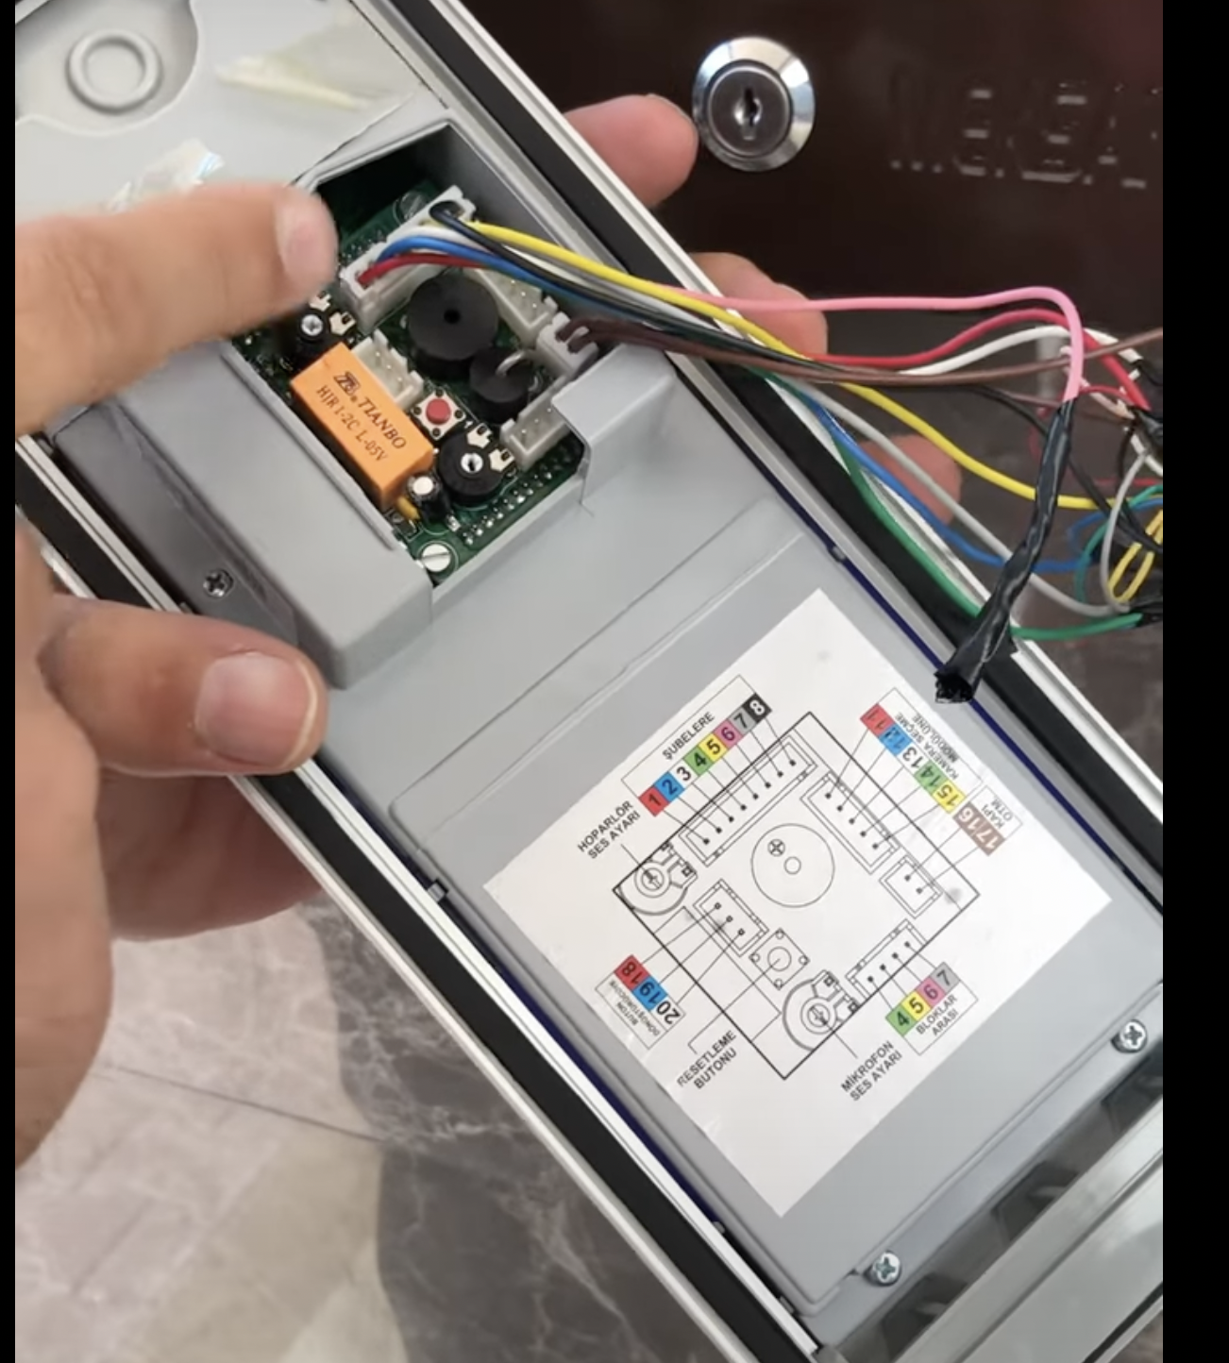
cat backdoors.txt

Slide 16
./popular.sh
- Audio
- Perkotek
- ERD-1120
- Efes Digital Panel
- AC 13PX

Slide 17
Smart Lock Documentation CENSORED

Slide 18
./scrape-the-world.sh
- https://github.com/MarioVilas/googlesearch
- https://github.com/rocketlaunchr/google-search
- https://github.com/NikolaiT/GoogleScraper

Slide 19
./dorks.sh
- filetype:pdf “BRAND_NAME” “password”
- filetype:docx “BRAND_NAME” “password”
- filetype:docx “BRAND_NAME” “admin”
- filetype:pdf “BRAND_NAME” “admin”
- filetype:log “BRAND_NAME”
- filetype:txt “BRAND_NAME”
- filetype:exe “BRAND_NAME”

Slide 20
./automation.sh
- Create automation to get all urls with Google Search with specific Dorks
- Download all of the urls
- String analysis (if possible)
- Most of the time not possible :(

Slide 21
Fmanuel
- Analyse the downloaded files
- Get Passwords
- Get Admin Functionalities
- Get Backdoors

Slide 22
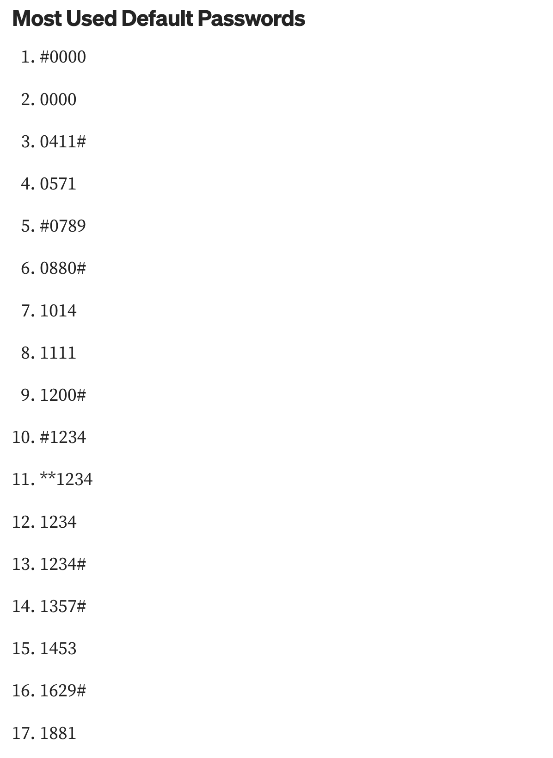
cat passwords.txt

Slide 23
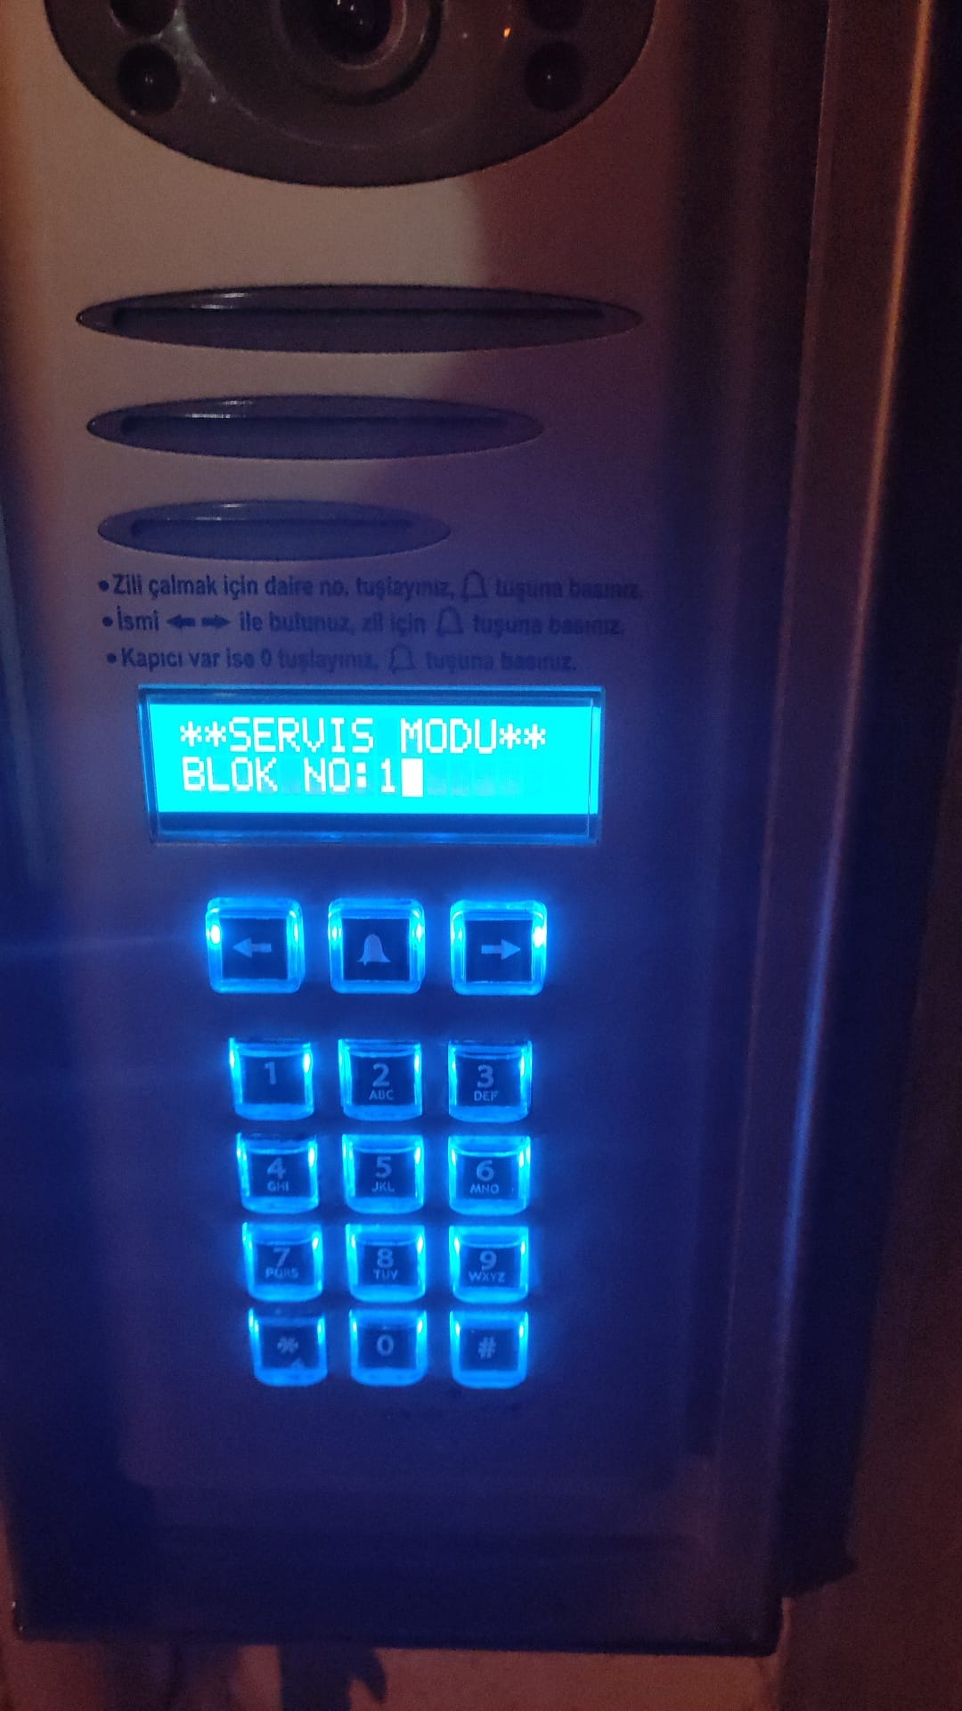
./test.sh

Slide 24
./test.sh

Slide 25
sudo su
- Use Admin password to access Admin Functionalities
- Disable Alarm
- Change Password
- Disable Camera
- Update Firmware

Slide 26
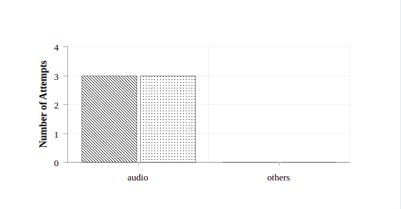
./stats.sh
For Contribution Contact Me : in/aydinnyunus

Slide 27
./gatecracker
- I create a Documentation for Most Popular Smart Locks in Turkey
- You can contribute on Github to Add More Smart Locks around the World

Slide 28
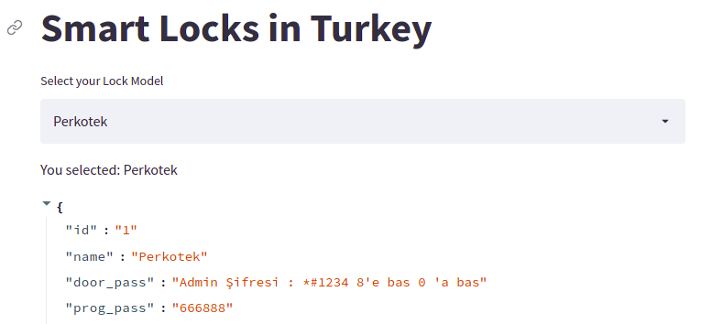
./gatecracker
https://share.streamlit.io/aydinnyunus/gatecracker/main/main.py

Slide 29
./gatecracker
https://share.streamlit.io/aydinnyunus/gatecracker/main/main.py

Slide 30
./gatecracker-api
- REST API for the Frontend

Slide 31
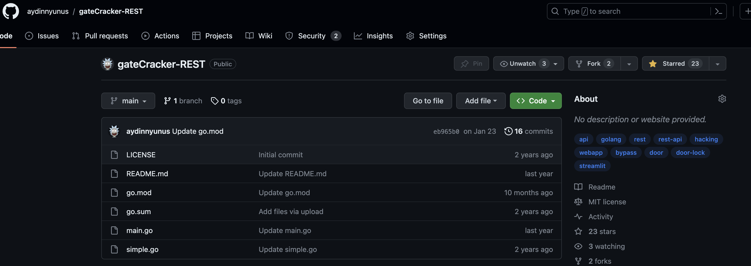
./gatecracker-api
https://github.com/aydinnyunus/gateCracker-REST

Slide 32
./contribute.sh
- Merge Request
- Scrape Smart Locks in your Country
- If you have, Try the Default Passwords and see if it is working

Slide 33
./remediation.sh
- Changing Default Settings
- Regular Firmware Updates
- Physical Security Measures
- Educating Users
- Engaging with Manufacturers
- Conducting Regular Security Audits
- Community Collaboration for Best Practices

Slide 34
Thank You !
Yunus AYDIN - in/aydinnyunus
aydinnyunus@gmail.com

Slide 35
read -p “Question:” q

